Slide 1

Jiaji Sun

Slide 2

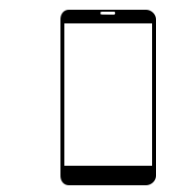
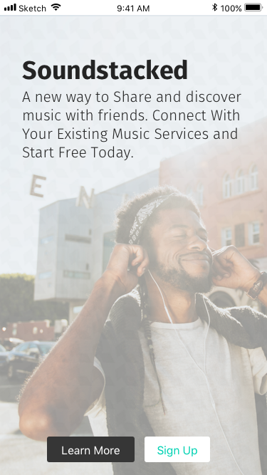
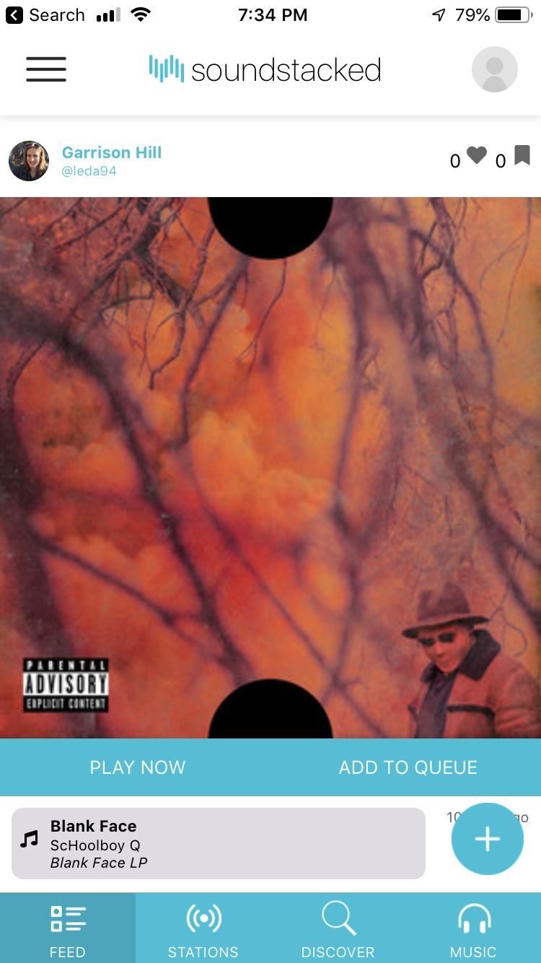
S♮und ⏯stacked
Group Member:
Qibang Liu, Kyle Andrews
Jiaji Sun, Jonathan Harvey
Sep. 2018
Jun. 2019
The project was inspired by the lack of good music sharing and recommendation services as well as lack of social capabilities on existing music platforms.
Soundstacked aims to create a full-featured social media platform for music sharing and discovery.
It evolved from a prototype built for a class project.
Soundstacked creates value for streaming service providers as they receive streams through the application.
Users gain social interaction in their music discovery process.
Our target audience is music streaming service subscribers who are also active on social networks.
⠠⠞⠓⠁⠝⠅ ⠽⠕⠥ ⠋⠕⠗ ⠗⠑⠁⠙⠊⠝⠛ ⠍⠽ ⠏⠕⠗⠞⠋⠕⠇⠊⠕.

Slide 3

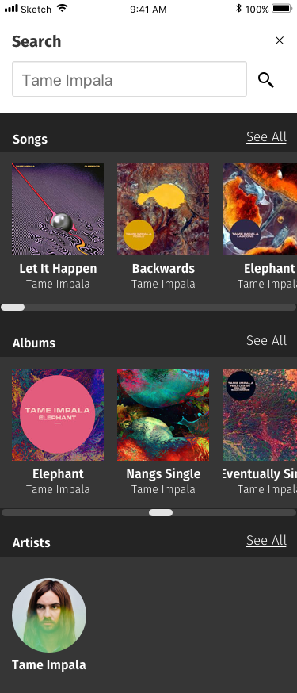
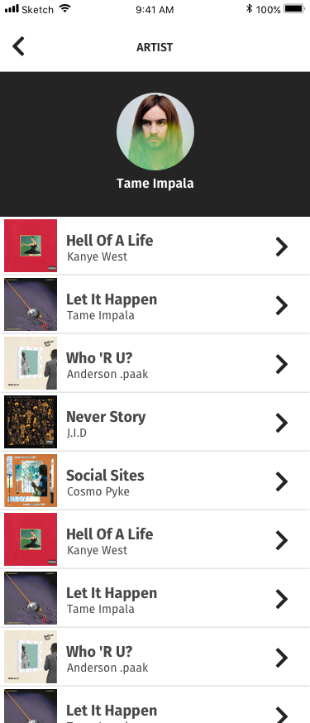
WHAT
Soundstacked is a free to use mobile application that links to your existing Spotify account. It will be available for both iOS and Android and was built using React Native.
The fundamental concept of the application is to bring a social aspect to the music discovery process and to create a platform where users can integrate their existing music streaming service, allowing them to play all of the new music that they discover.
This project is meant to be a minimum viable product prototype that will act as the basis for more iterations and feature development at a later time.
⠠⠞⠓⠁⠝⠅ ⠽⠕⠥ ⠋⠕⠗ ⠗⠑⠁⠙⠊⠝⠛ ⠍⠽ ⠏⠕⠗⠞⠋⠕⠇⠊⠕.

Slide 4
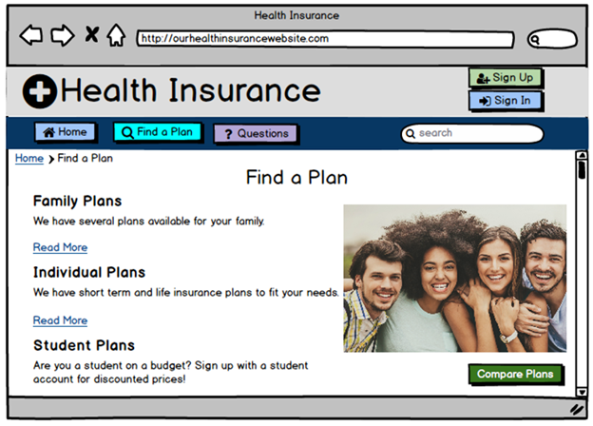
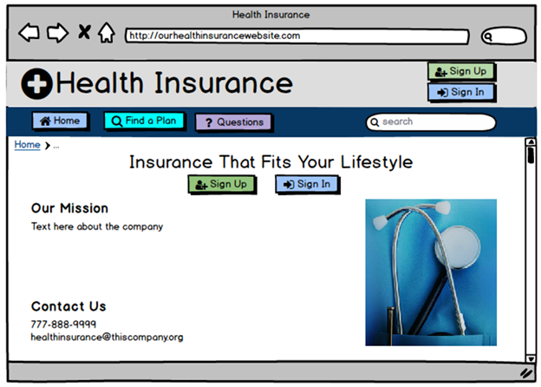
Health Insurance Website
Group Member:
Katherine Jeffrey, Jiaji Sun, Dominic Wasko, Adam Puckette
Sep. 2018
Dec. 2018
People who suffer from ADHD have a much harder time keeping focus than others. They are very easily distracted, and can forget what they were doing when they become distracted sometimes. Many websites are not designed very well, and most of the important links are hidden under various submenus. A confusing or disorganized website would be much harder for a person with ADHD to navigate without getting lost or distracted, and a health insurance website is a perfect example. Many websites redirect you through a number of pages advertising the company while you are trying to sign up as well.

Slide 5
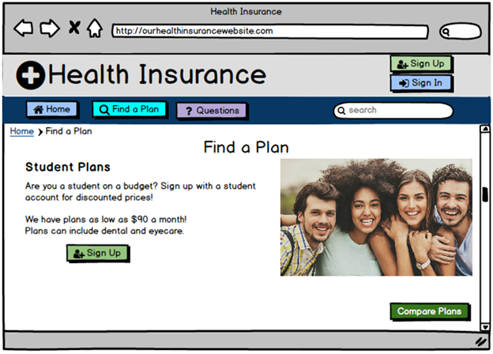
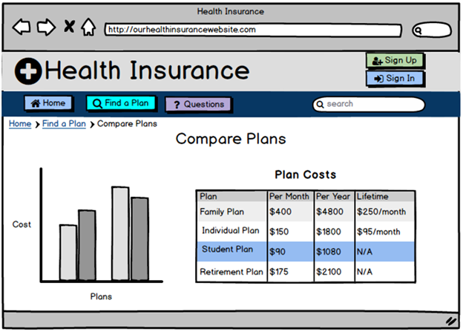
WHAT
For this project, we have chosen to design a website. We are going to be designing a health insurance website. Many people who have ADHD need to get medication and most people will need to sign up for their own health insurance plan at some point and if websites are not designed with usability in mind, they can be confusing for people to navigate even if they do not have ADHD.
Our group is using people with ADHD (Attention Deficit Hyperactivity Disorder) as our underrepresented population.Signing up for health insurance is something that almost everyone will need to do at some point, and many insurance websites are confusing to use with multiple links leading to the same place on every page. This is designed to keep redirecting you to sign up links to keep you on the website. Unfortunately this process can be very confusing to use, and usability can be improved a lot. These types of problems are made significantly more confusing and distracting for people with ADHD.

Slide 6
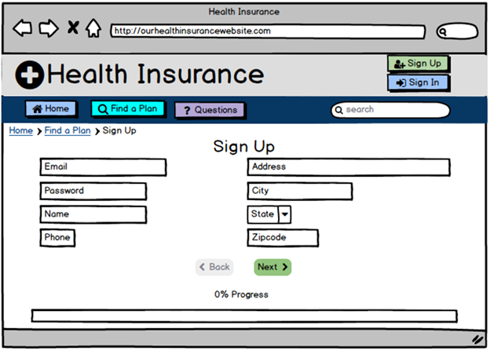
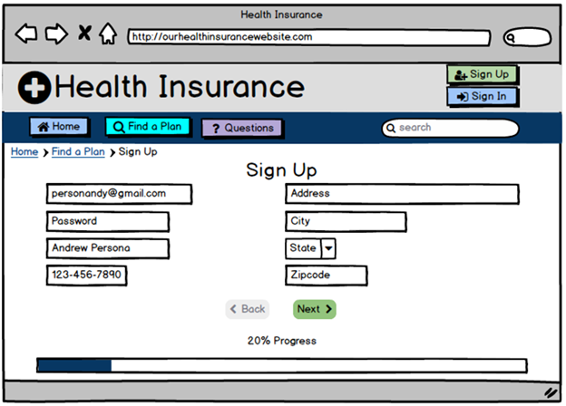
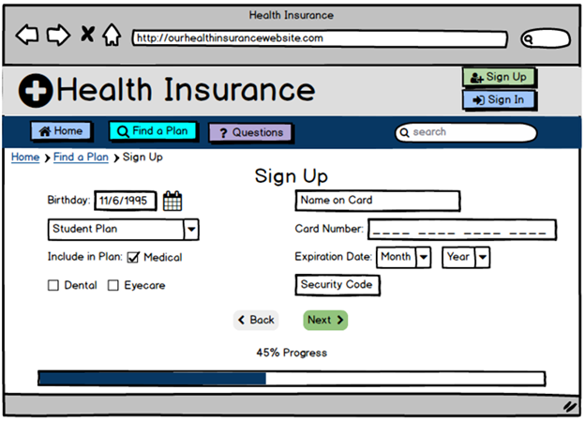
Prototype

Slide 7
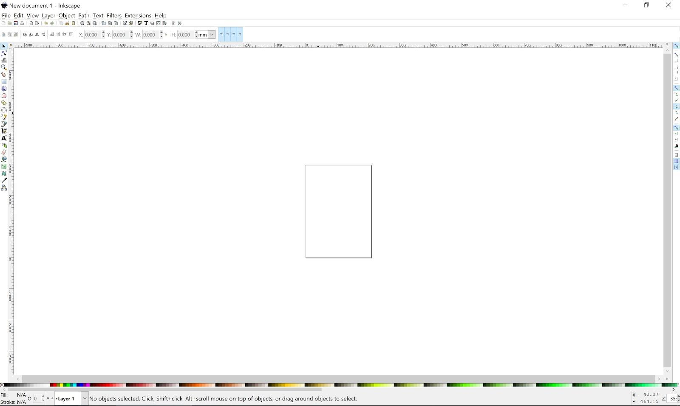
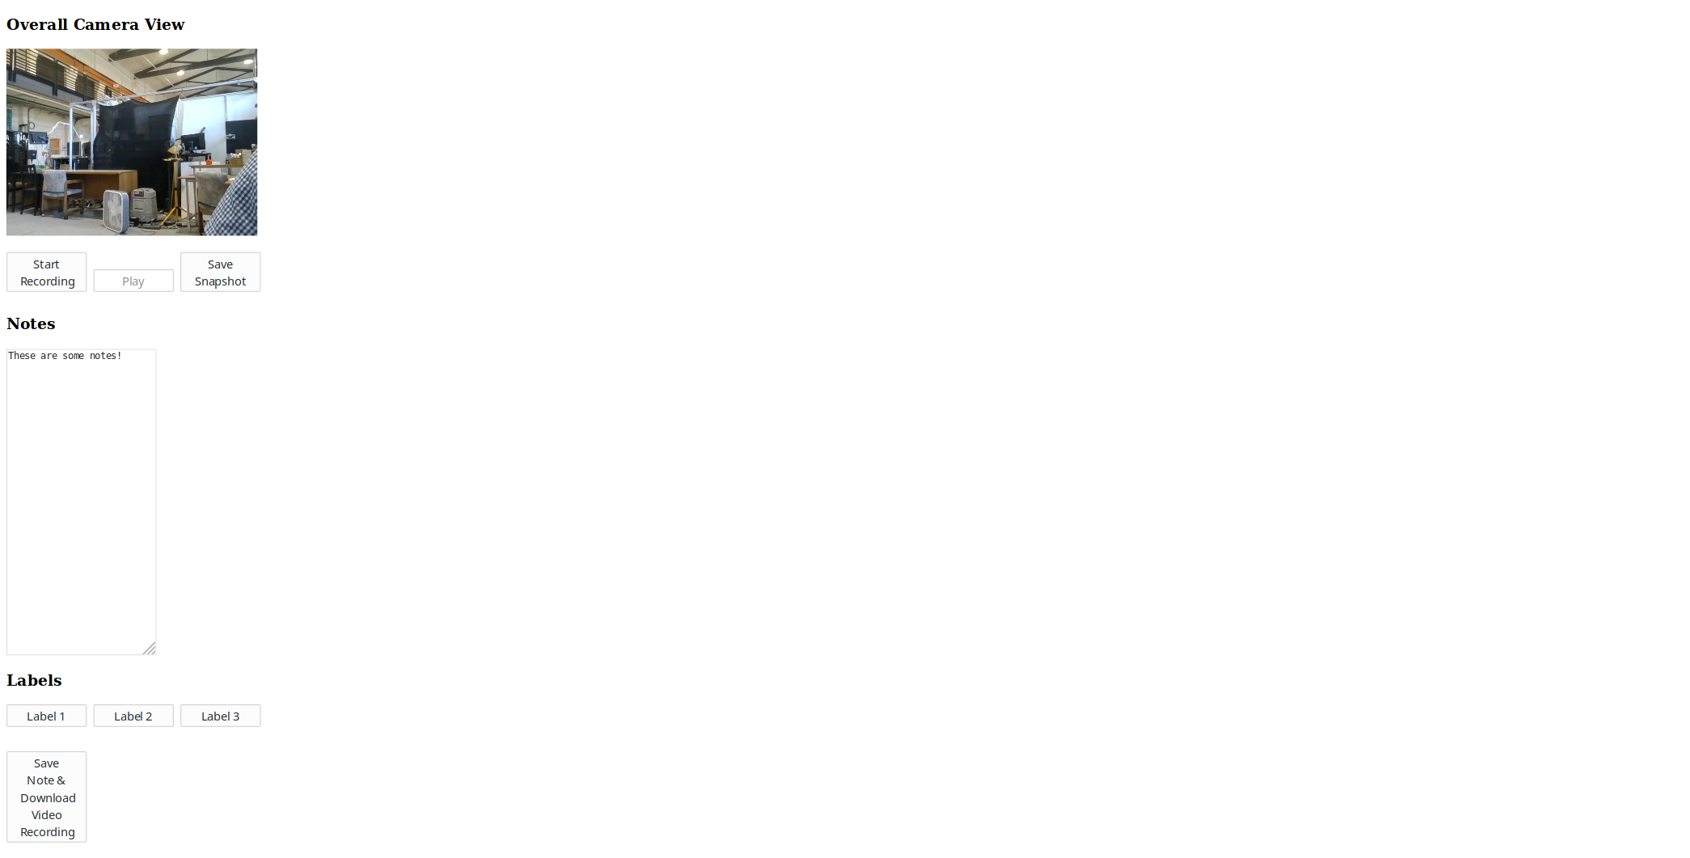
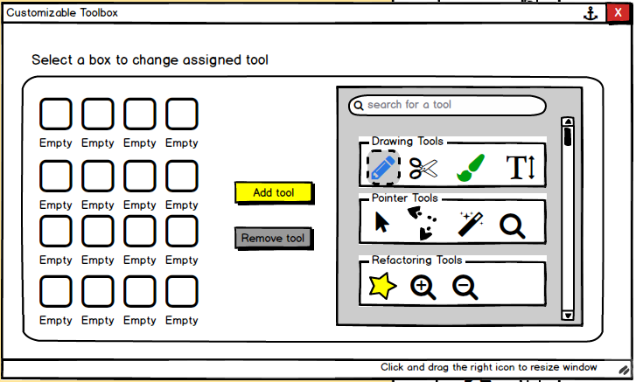
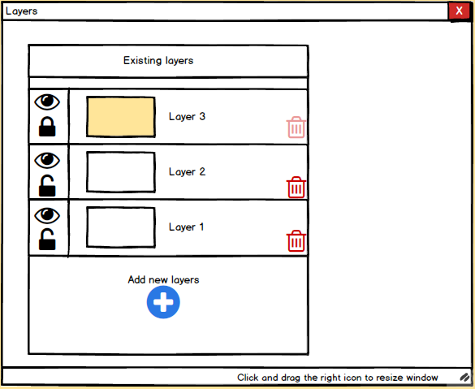
Inkscape Interface Design
Social Robot Annotation system
Redesign the interface of Inkscape by used Balsamiq within a 4-people group
Build a web system help making annotations for social robot research

